Slide 2
Learning Objectives
LO 10.1 Define bathymetry and describe the various bathymetric techniques used to map the ocean floor.
LO 10.2 Compare and contrast a passive continental margin with an active continental margin and list the major features of each.
LO 10.3 List and describe the major features of the deep-ocean basin.
LO 10.4 Sketch and label a cross-sectional view of the Mid-Atlantic Ridge. Explain how a cross section of the East Pacific Rise would look different.

Slide 3
Learning Objectives (cont.)
LO 10.5 Write a statement describing how spreading rates affect ridge topography.
LO 10.6 List the four layers of oceanic crust and explain how oceanic crust forms and how it differs from continental crust.
LO 10.7 Outline the steps by which continental rifting results in the formation of new ocean basins.
LO 10.8 Compare and contrast spontaneous subduction and forced subduction.

Slide 4
10.1 An Emerging Picture of the Ocean Floor
Mapping the seafloor
From 1872 to 1876, the HMS Challenger collected oceanographic data.
Measured the depth to the seafloor by lowering weighted lines overboard.
Deepest spot measured is now called the Challenger Deep.

Slide 5
10.1 An Emerging Picture of the Ocean Floor (cont.)
Mapping the Seafloor
Modern bathymetric techniques
The topography (shape) of the ocean floor is called bathymetry
Sonar, using sound energy, is now used to measure the depth to the ocean floor.
Early bathymetric profiles were created using echo sounders, which bounce a sound off an object to determine the distance.

Slide 6
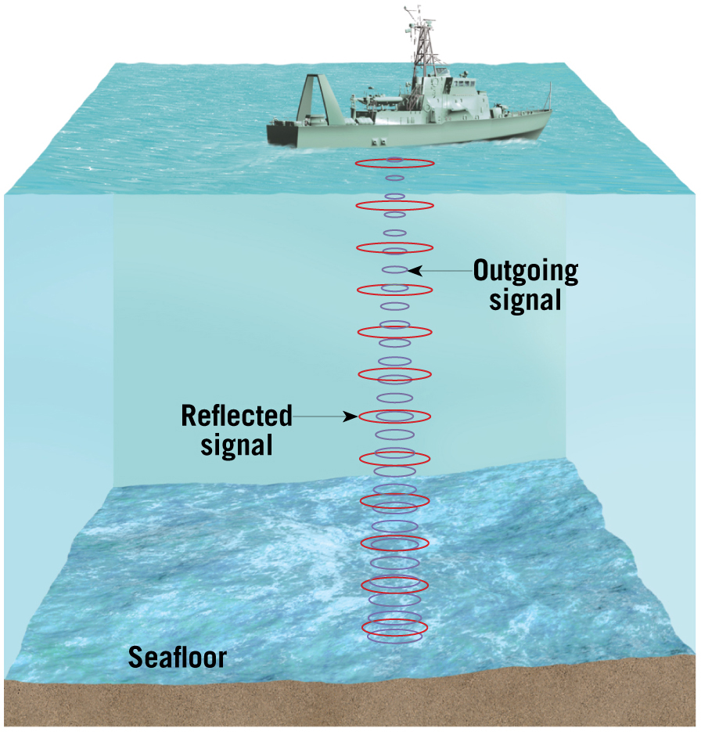
Echo Sounder

Slide 7
10.1 An Emerging Picture of the Ocean Floor
Mapping the seafloor
Modern bathymetric techniques
Sidescan sonar images a horizontal region above the seafloor.
High-resolution multibeam instruments send out a fan of sound and record reflections from various receivers to provide a more detailed view of the ocean floor.
Only about 5 percent of the seafloor has been mapped in detail.

Slide 8
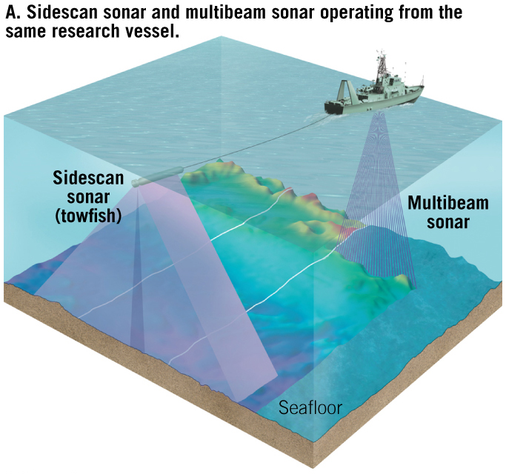
Sidescan and Multibeam Sonar

Slide 9
10.1 An Emerging Picture of the Ocean Floor
Mapping the seafloor
Mapping the ocean floor from space
Massive underwater structures exert stronger-than-normal gravitational attraction.
Water piles up over these features.
Satellite radar altimeters can detect changes in elevation of the ocean surface.

Slide 10
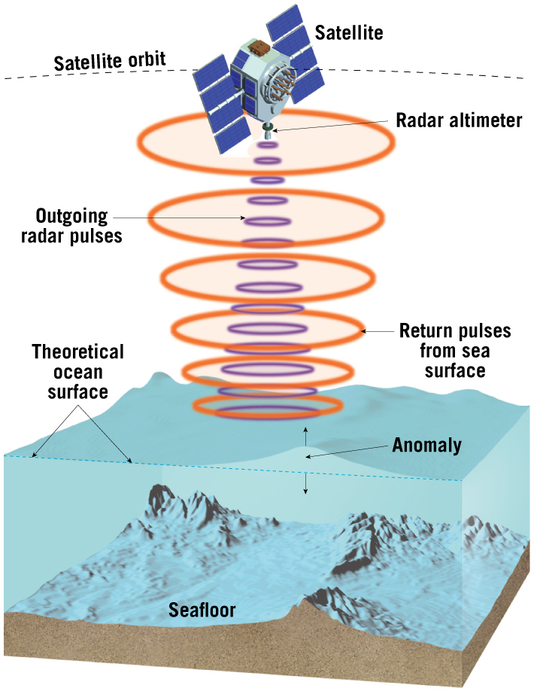
Satellite Altimeter

Slide 11
10.1 An Emerging Picture of the Ocean Floor
Three major provinces of the ocean floor
Continental margins
Deep-ocean basins
Oceanic (mid-ocean) ridges

Slide 12
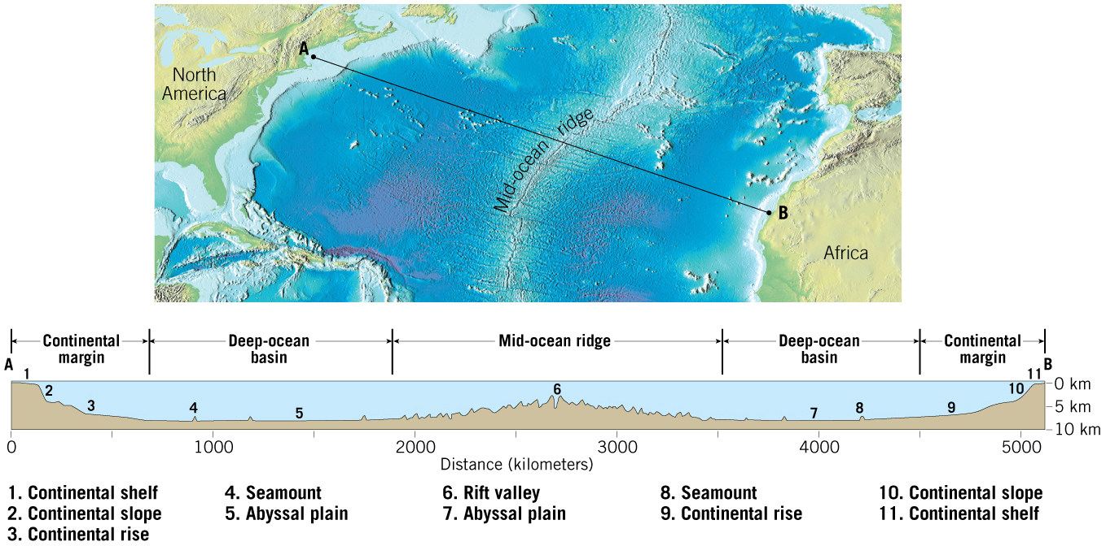
Major Topographic Divisions of the North Atlantic

Slide 13
10.2 Continental Margins
Passive continental margins
Found along most coastal areas that surround the Atlantic ocean
Not associated with plate boundaries
Experience little volcanism and few earthquakes

Slide 14
10.2 Continental Margins (cont.)
Features comprising a passive continental margin
Continental shelf
Flooded extension of the continent
Varies greatly in width
Gently sloping
Contains important mineral deposits
Some areas are mantled by extensive glacial deposits.

Slide 15
10.2 Continental Margins (cont.)
Features comprising a passive continental margin
Continental slope
Marks the seaward edge of the continental shelf
Relatively steep structure
Boundary between continental crust and oceanic crust

Slide 16
10.2 Continental Margins (cont.)
Features comprising a passive continental margin
Continental rise
Found in regions where trenches are absent
Continental slope merges into a more gradual incline—the continental rise.
Thick accumulation of sediment
At the base of the continental slope, turbidity currents deposit sediment that forms deep-sea fans.

Slide 17
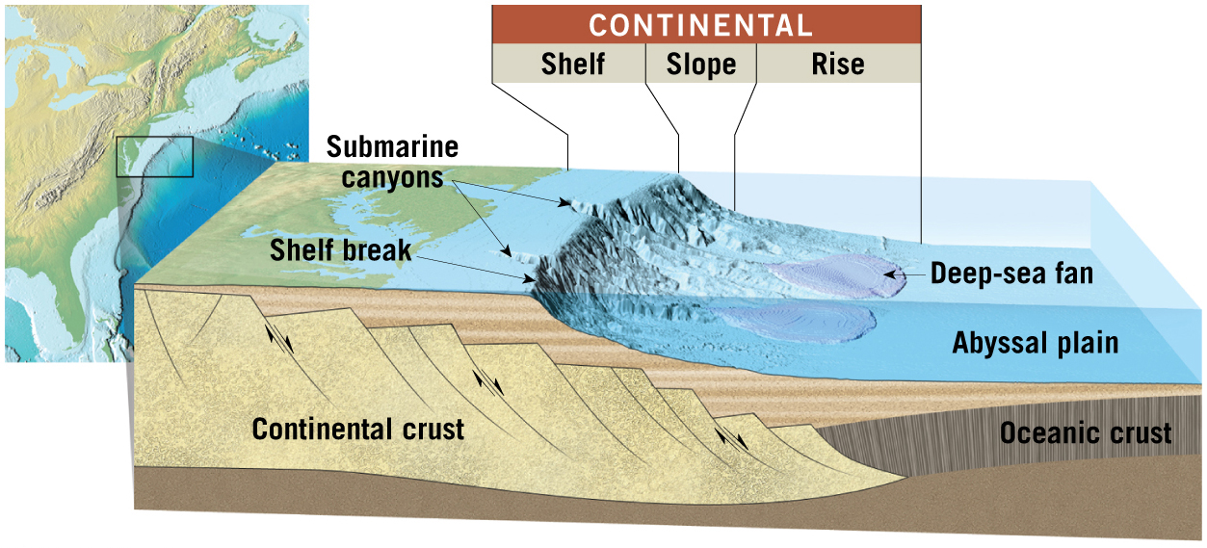
Passive Continental Margins
Tutorial

Slide 18
10.2 Continental Margins
Active continental margins
Continental slope descends abruptly into a deep-ocean trench.
Located primarily around the Pacific Ocean
Accumulations of deformed sediment and scraps of ocean crust form accretionary wedges.

Slide 19
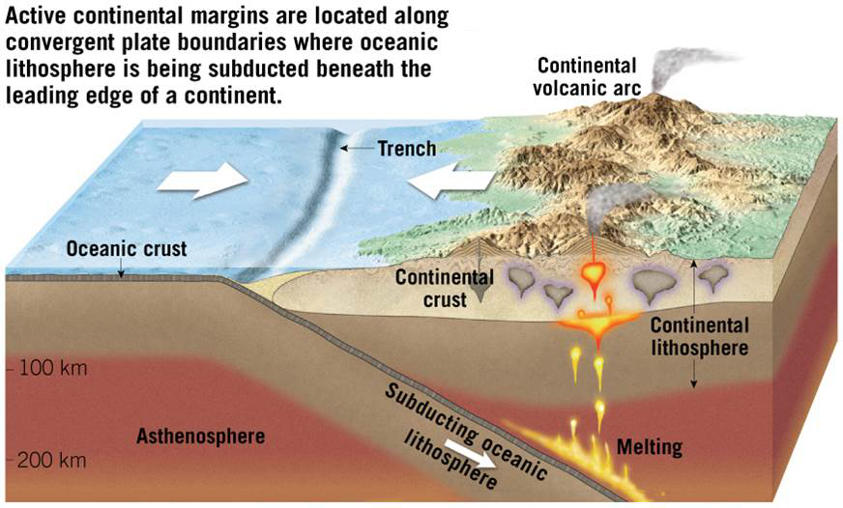
Active Continental Margin

Slide 20
10.3 Features of Deep-Ocean Basins
Deep-ocean trench
Long, relatively narrow features
Deepest parts of ocean
Most are located in the Pacific Ocean
Sites where moving lithospheric plates plunge into the mantle
Associated with volcanic activity

Slide 21
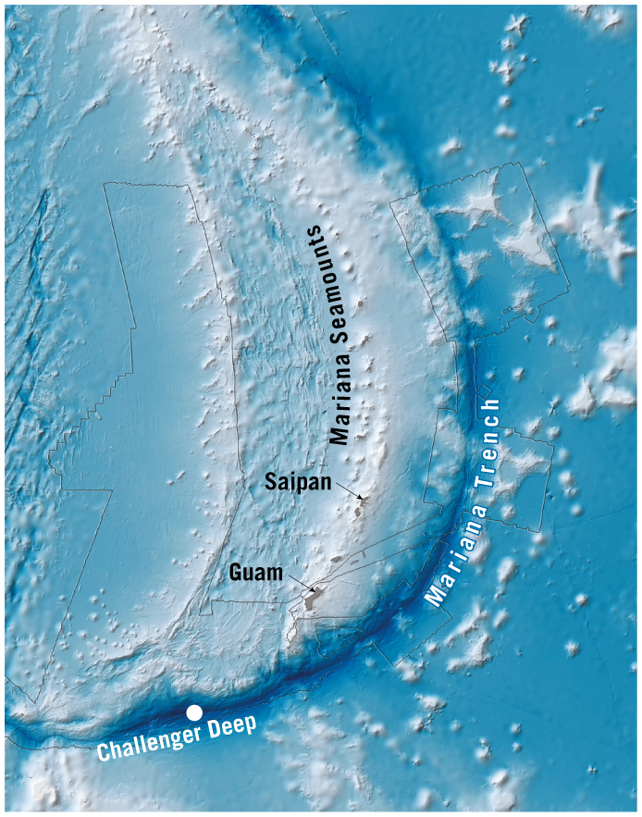
The Challenger Deep

Slide 22
10.3 Features of Deep-Ocean Basins
Abyssal plains
Likely the most level places on Earth
Sites of thick accumulations of sediment
Found in all oceans

Slide 23
10.3 Features of Deep-Ocean Basins (cont.)
Volcanic structures on the ocean floor
Seamounts
Isolated volcanic peaks
Many form near oceanic ridges
May emerge as an island
Guyots
Seamounts that sink and form flat-topped mountains
Below surface of water
Oceanic plateaus
Vast outpourings of basaltic lavas on the ocean floor

Slide 24
10.3 Features of Deep-Ocean Basins (cont.)
Volcanic structures on the ocean floor
Coral atolls
Ring-shaped structures of corals
Found at depths of several thousand meters
Darwin hypothesized that this was formed due to subsiding volcanoes.

Slide 25
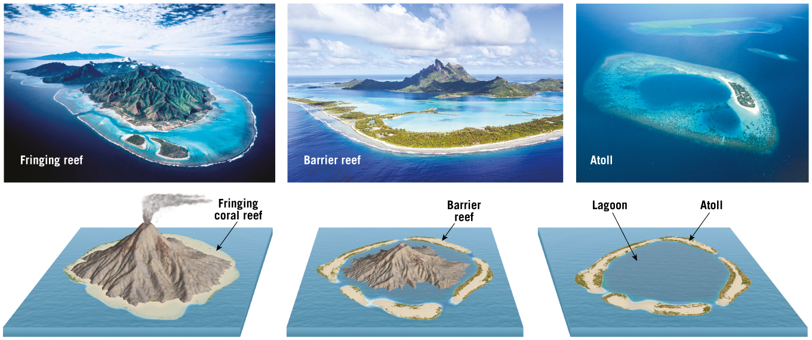
Darwin’s Hypothesis

Slide 26
10.4 Anatomy of the Oceanic Ridge
Oceanic ridge: Broad, linear swells along divergent plate boundaries
Occupy elevated positions
Extensive faulting and earthquakes
High heat flow
Numerous volcanic structures

Slide 27
10.4 Anatomy of the Oceanic Ridge (cont.)
Oceanic ridge characteristics
Longest topographic feature on Earth’s surface
More than 70,000 kilometers (43,000 miles) in length
20% of Earth’s surface
Winds through all major oceans
Term ridge is misleading; widths of 1000 to 4000 kilometers give the appearance of broad, elongated swells

Slide 28
10.4 Anatomy of the Oceanic Ridge (cont.)
Oceanic ridge characteristics
Axis of some ridge segments exhibit deep, down-faulted structures called rift valleys.
Portions of the mid-Atlantic ridge have been studied in considerable detail.

Slide 29
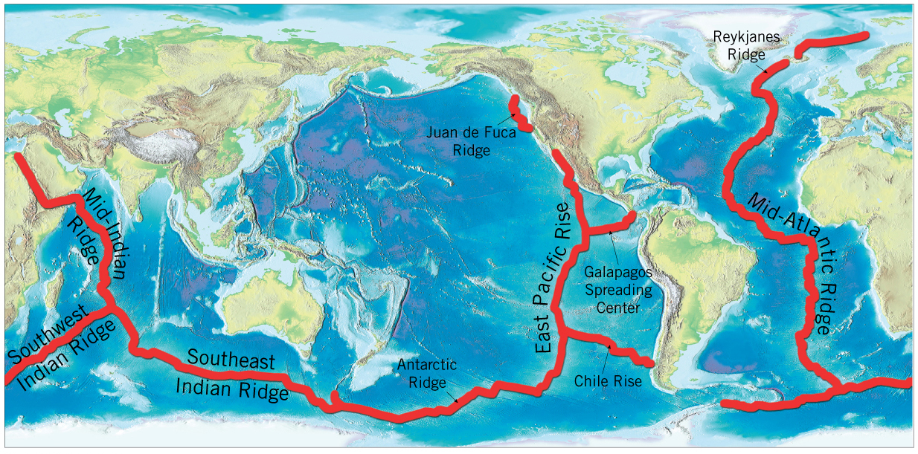
Distribution of the Oceanic Ridge System

Slide 30
10.5 Ocean Ridges & Seafloor Spreading
Seafloor spreading
Concept formulated in the early 1960s by Harry Hess
Seafloor spreading occurs along relatively narrow zones, called rift zones, located at the crests of ocean ridges.
As plates move apart, magma wells up into the newly created fractures and generates new slivers of oceanic lithosphere.
New lithosphere moves from the ridge crest in a conveyor-belt fashion.

Slide 31
10.5 Ocean Ridges & Seafloor Spreading (cont.)
Why are oceanic ridges elevated?
Newly created oceanic lithosphere is hot and occupies more volume than cooler rocks.
As the basaltic crust travels away from the ridge crest, it is cooled by seawater.
As the lithosphere moves away, it thermally contracts and becomes more dense.

Slide 32
10.5 Ocean Ridges & Seafloor Spreading (cont.)
Spreading rates and ridge topography
Ridge systems exhibit topographic differences.
Topographic differences are controlled by spreading rates.
At slow spreading rates (1– cm per year), a prominent rift valley develops along the ridge crest that is usually 30 to 50 kilometers across and 1500–3000 meters deep.

Slide 33
10.5 Ocean Ridges & Seafloor Spreading (cont.)
Spreading rates and ridge topography
Topographic differences are controlled by spreading rates.
At intermediate spreading rates (5–9 cm per year), rift valleys that develop are shallow and less than 200 meters deep.
At spreading rates greater than 9 centimeters per year, no median rift valley develops and these areas are usually narrow and extensively faulted.

Slide 34
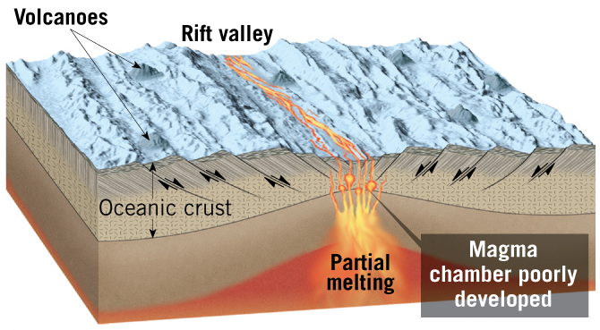
Slow Spreading Oceanic Ridge

Slide 35
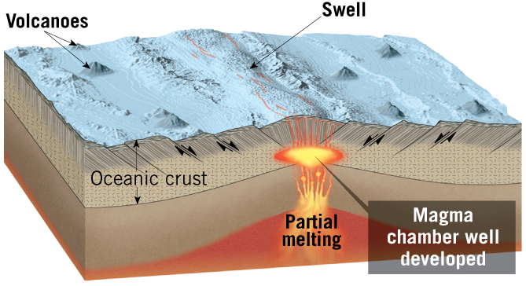
Fast Spreading Oceanic Ridge

Slide 36
10.6 The Nature of Oceanic Crust
Four distinct layers, in a sequence of rocks called an ophiolite complex
Layer 1: Sequence of unconsolidated sediments
Layer 2: Consisting of pillow lavas
Layer 3: Numerous interconnected dikes called sheet dikes
Layer 4: Gabbro

Slide 37
10.6 The Nature of Oceanic Crust (cont.)
Formation of oceanic crust
Basaltic magma originates from partially melted mantle peridotite.
Molten rock injected into fractures above the magma chambers creates the sheeted dike complex.
The submarine lava flows chill quickly and the congealed margin is forced forward to produce large tube-shaped protuberances known as pillow basalts.

Slide 38
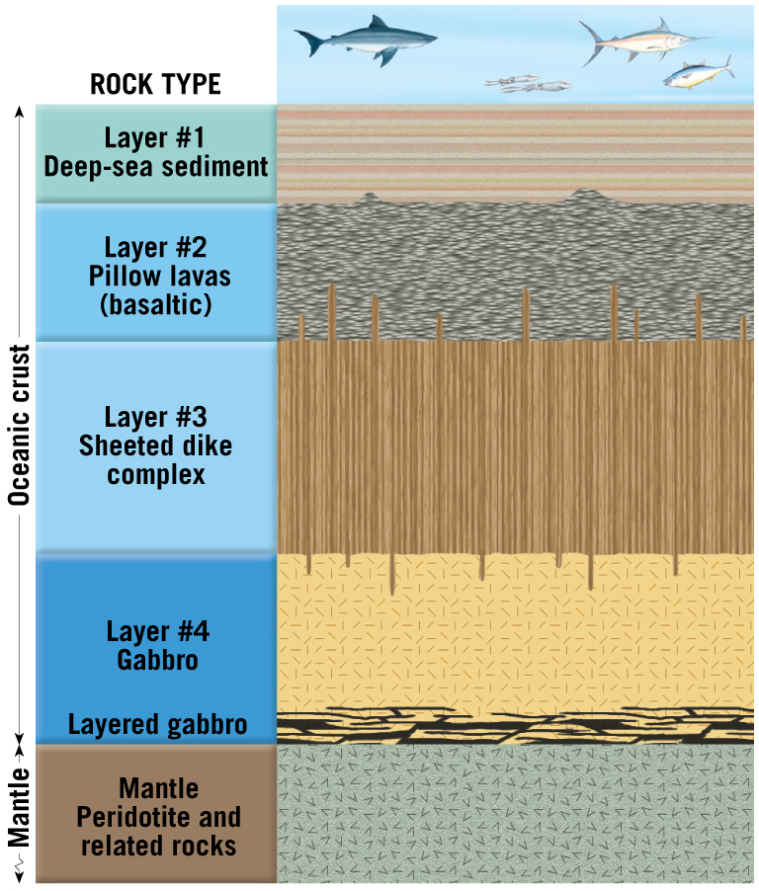
Structure of the Oceanic Crust

Slide 39
10.6 The Nature of Oceanic Crust
Interactions between seawater and oceanic crust
Seawater circulates downward through the highly fractured crust.
Basaltic rock is altered by hydrothermal metamorphism.
Hydrothermal fluids dissolve ions of various metals and precipitate them on the seafloor as particle-filled clouds called black smokers.

Slide 40
10.7 Continental Rifting: The Birth of a New Ocean Basin
Evolution of an ocean basin
A new ocean basin begins with the formation of a continental rift.
Splits landmasses into two or more smaller segments
Examples include the East African Rift, Baikal Rift, the Rhine Valley, Rio Grand Rift, and the Basin and Range.
The Red Sea is an example of a rift valley that has lengthened and deepened in a narrow linear sea.

Slide 41
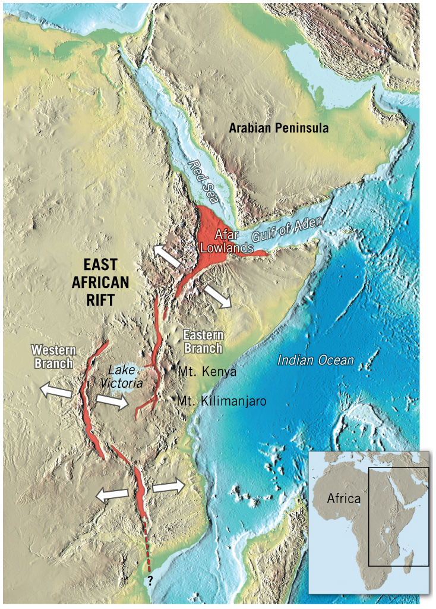
East Africa Rift Valley
Tutorial

Slide 42
10.7 Continental Rifting: The Birth of a New Ocean Basin
Evolution of an ocean basin
Atlantic Ocean
After tens of millions of years, the Red Sea will develop into a feature similar to the Atlantic Ocean.
As new oceanic crust was added to the diverging plates, the rifted margins moved further from the region of upwelling.
These margins cooled and subsided below sea level.

Slide 43
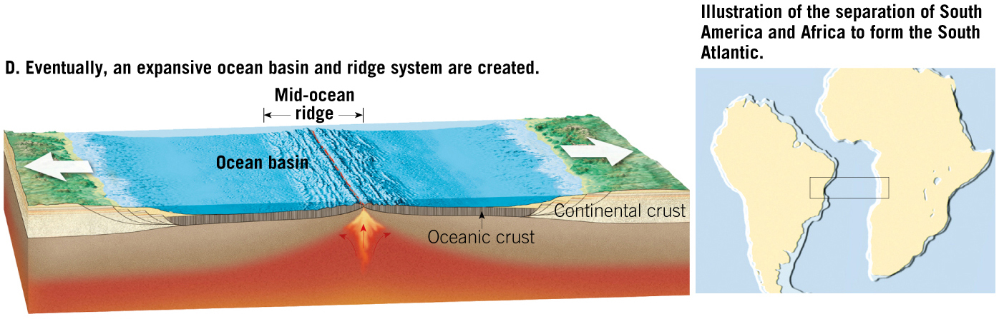
Formation of an Ocean Basin
Animation

Slide 44
10.7 Continental Rifting: The Birth of a New Ocean Basin
Failed rifts
Formerly active rift valley is filled with basalt and clastic sedimentary rocks.
Why rifts fail or succeed is not fully understood.

Slide 45
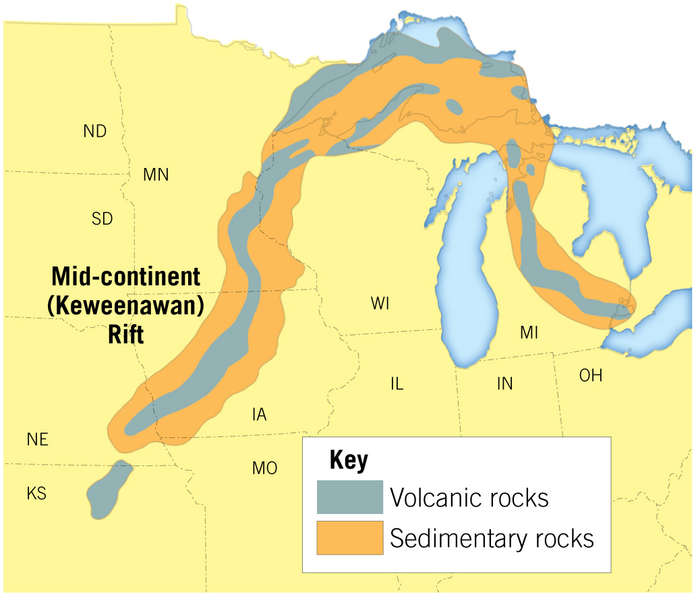
Failed Rift

Slide 46
10.8 Destruction of Oceanic Lithosphere
Why oceanic lithosphere subducts
Spontaneous subduction
Very old, thick, dense lithosphere sinks to the mantle by its own weight.
Results in descending angles of nearly 90 degrees
Example: Mariana trench
Lithospheric mantle is what drives subduction.

Slide 47
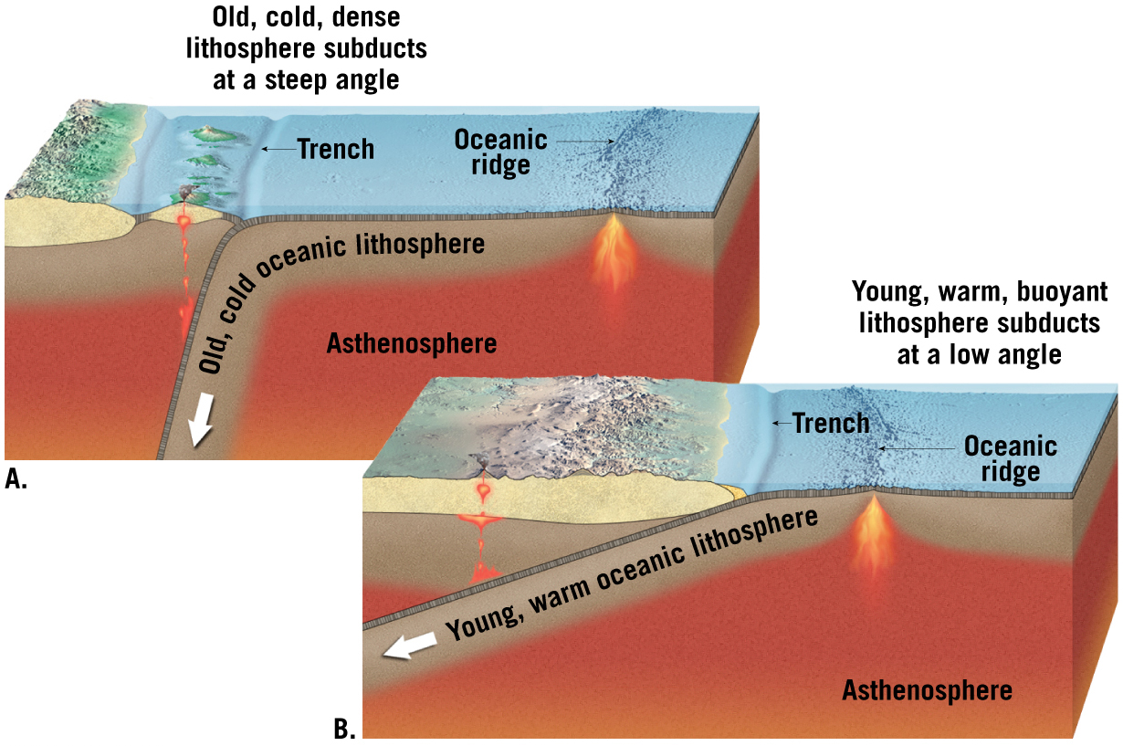
The Angle of Plate Subduction Depends on Its Density

Slide 48
10.8 Destruction of Oceanic Lithosphere
Why oceanic lithosphere subducts
Forced subduction
Younger, less dense lithosphere is forced beneath the overlying plate by compressional forces.
Descends at shallow angles
Example: Peru–Chile trench

Slide 49
10.8 Destruction of Oceanic Lithosphere (cont.)
Subducting plates: The demise of an ocean basin
The Farallon plate once occupied much of the eastern Pacific basin
Beginning 180 million years ago, the Farallon plate was subducting beneath the Americas faster than it was being generated.
The plate got continually smaller and now only fragments of the original plate remain as the Juan de Fuca, Cocos, and Nazca plates.

Slide 50
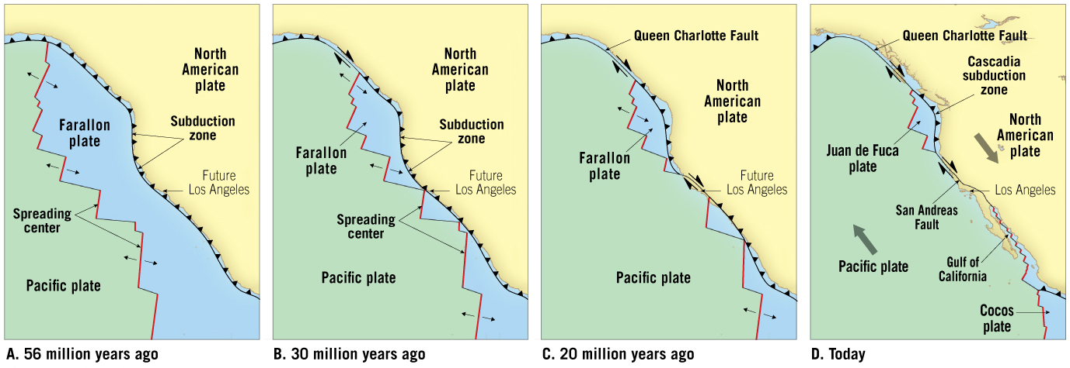
Demise of the Farallon Plate
Tutorial

